Slide 1



18ECP105L-MINOR PROJECT iii
DETECTION OF STREET AND RIVER POLLUTED AREA
USING DRONE MAPPING SYSTEM
PRESENTED BY:
N.RESHMA (927622BEC165)
K.S.PRABHAVATHI (927622BEC145)
P.PRIYADHARSHINI (927622BEC156)
M.SAMUTHRA (927622BEC170)
Guided by:
Dr.S.MEIVEL

Slide 2
Problem Statement
Pollution in urban environments and water bodies, such as rivers, poses significant threats to public health, ecosystems, and urban infrastructure. Traditional methods of monitoring pollution are often inefficient, costly, and unable to provide real-time data, particularly in hard-to-reach areas like polluted riverbanks, industrial zones, and densely populated urban streets.
There is a critical need for a scalable, accurate, and cost-effective solution that can detect, monitor, and assess pollution in real-time while enabling swift intervention and informed decision-making by environmental agencies, local governments, and the public.

Slide 3
Objective of the invention
To leverage drone mapping systems for efficient detection and management of street and river pollution by providing real-time, accurate data that enhances environmental monitoring, promotes public health, and supports sustainable urban planning.
The aim is to integrate advanced drone technology to address pollution challenges more effectively, contributing to a cleaner, healthier environment.

Slide 4
abstract
An innovative drone-based mapping system detects and monitors pollution. Targeting river bodies and urban environments, it combines advanced technologies. High-resolution cameras, multispectral/hyperspectral imaging, LIDAR, and IoT controllers are utilized. Drones capture aerial imagery and environmental data from hard-to-reach areas. Image processing algorithms analyze data to detect and classify pollution. Pollution severity is assessed based on predefined thresholds. Data is uploaded to the cloud for secure storage and real-time accessibility. A user-friendly mobile app provides updates on pollution levels. Stakeholders collaborate through cloud computing and IoT integration. Enhancing pollution detection, management, and mitigation efforts. Ultimately, this system offers a cost-effective, highly accurate, and sustainable solution for addressing pollution in urban areas and water bodies, with the potential to significantly contribute to environmental protection, public health, and urban planning.

Slide 5
LITERATURE SURVEY
Zhang et al. (2016): "Drone-Based Monitoring of Air Pollution: Tracking Gas Emissions and Particulate Matter in Urban Environments"
This study demonstrates the ability of drones equipped with optical and infrared cameras to detect air pollution in urban areas. The drones are used to track gas emissions from automobiles and industrial sites, as well as monitor particulate matter concentrations. The study highlights how infrared footage captured by UAVs with multispectral cameras can be used to identify pollution hotspots in cities.
Wang et al. (2020): "Utilizing UAVs for River Ecosystem Monitoring: Assessing Vegetation Health, Water Flow, and Turbidity Levels"
This research investigates the use of drones to monitor environmental changes along rivers, including assessing water quality indicators such as turbidity levels, vegetation health, and water flow. The study shows how UAVs can provide valuable data on river pollution and ecosystem health, particularly in hard-to-reach areas that are difficult to monitor using traditional methods.

Slide 6
El Hadi et al. (2018): "Urban Air Quality Assessment Using UAV-Mounted Gas Sensors: A Case Study of Traffic and Industrial Pollution"
In this study, UAVs equipped with gas sensors were used to assess air quality in urban streets. The UAVs measured concentrations of nitrogen dioxide (NO2), carbon dioxide (CO2), and ozone (O3) at different altitudes in various urban locations. The results revealed pollution patterns linked to traffic congestion and industrial zones, offering useful insights for urban planners and environmental agencies.
Guerra et al. (2021): "Real-Time Air Quality Monitoring with UAVs: Detecting Particulate Matter and Predicting Pollution Trends Using Machine Learning"
This study presents a drone-based air quality monitoring system for detecting particulate matter (PM2.5 and PM10) in real-time. The UAVs are equipped with sensors and combined with machine learning algorithms to identify high pollution areas and predict future trends in air quality. The approach offers a dynamic and flexible alternative to traditional fixed air quality monitoring stations.

Slide 7
Flow Chart of Proposed system and method
Mapping the images
Detect polluted area
No
Cloud the data – Display “No Polluted area” in mobile APK
Yes
Analysis polluted area which is maximum
If plastic>20% and Chemical > 20% and Waste food> 20% Light Polluted area>20%
No
yes
Cloud the polluted area
Monitoring in mobile APK

Slide 8
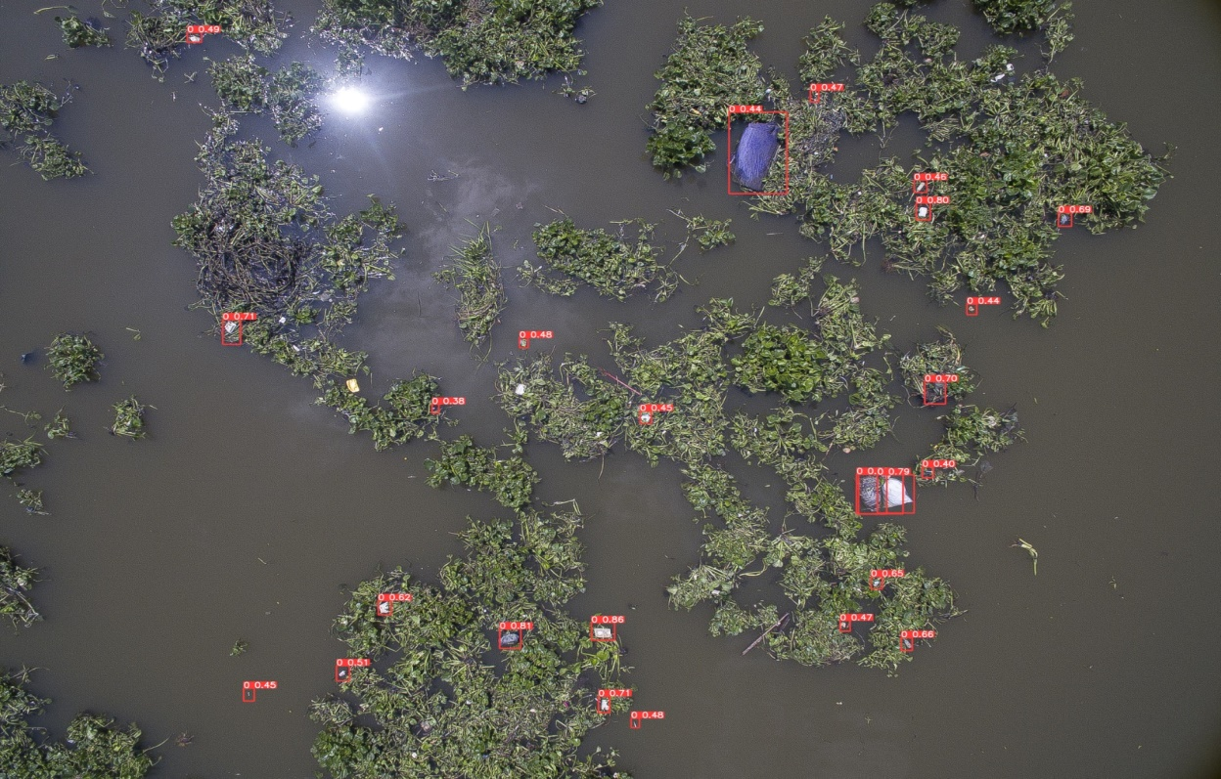
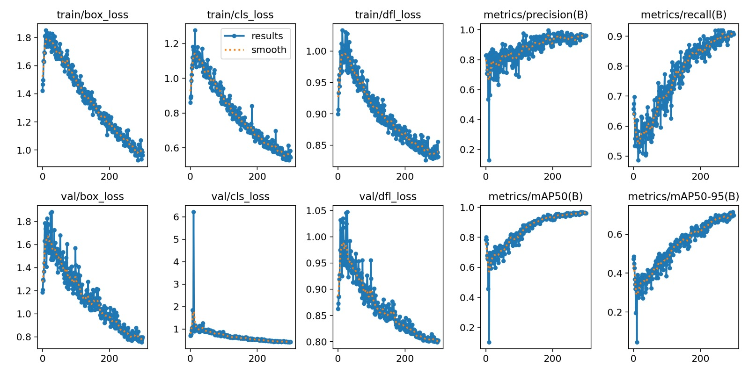
RESULT

Slide 9
CONCLUSION AND FUTURE WORK
The drone mapping system provided precise, real-time environmental data for effective pollution monitoring in urban streets and rivers.
It created pollution maps using GPS and GIS, highlighting hotspots of PM2.5, PM10, NO2, and CO emissions in high-traffic, industrial, and construction areas.
For rivers, drones monitored turbidity, pH, and dissolved oxygen to detect severe contamination near industrial discharge zones and agricultural runoff areas.
GIS-based visualizations enabled authorities to identify pollution sources, track changes over time, and assess remediation measures.
This integrated system supported focused interventions, making it a powerful tool for environmental management.

Slide 10


